Slide 1
Opportunities for Small Businesses through the Small Business Innovation Research Program (SBIR)
Government Technology & Services Coalition Event
Arlington, VA
Elissa I. Sobolewski
DHS SBIR Program Director
Science and Technology (S&T) Directorate
June 18, 2012

Slide 2
Small Business Innovation Research (SBIR) Program
One of the largest examples of U.S. public-private partnerships
Created in 1982 through the Small Business Innovation Development Act and reauthorized in 2011
Specific distinct program purposes are to:
Stimulate technological innovation;
Use small business concerns (SBC) to meet Federal research/research and development (R/R&D) needs;
Foster and encourage participation by socially and economically disadvantaged SBCs, and by women-owned SBCs, in technological innovation; and
Increase private sector commercialization of innovations derived from Federal R&D, thereby increasing competition, productivity and economic growth
P.L. 112-81 (signed 12/31/2011)
continues program through 09/30/2017

Slide 3
SBIR Program: A Mandatory Set-Aside Program
If an agency’s extramural R/R&D budget exceeds $100M,
Must set-aside 2.6% of its extramural R/R&D budget in FY12
Set-aside increases by 0.1% each subsequent year reaching 3.2% in FY17 and beyond
For small business concerns to engage in federal R&D with potential for commercialization
Through a 3-Phased R&D Approach
Phase I: Feasibility, 6 months, $150k
Phase II: Prototype Development, 2 years, $1M
Phase III: Commercialization, funded by private sector or federal agencies
agency set-aside can only be used for Phase I and II awards

Slide 4
SBIR Program: Small Business Concern Eligibility
Organized for-profit
place of business located in the U.S.;
operates primarily within the U.S.; or
which makes significant contribution to the U.S. economy through payment of taxes or use of American products, materials or labor
Is in the legal form of an individual proprietorship, partnership, limited liability company, corporation, joint venture, association, trust or cooperative
except that where the form is a joint venture, there can be no more than 49% participation by business entities in the joint venture

Slide 5
SBIR Program: Small Business Concern Eligibility
At least 51% owned and controlled by one or more individuals who are citizens of the U.S. or permanent resident aliens in the U.S.; or
at least 51% owned and controlled by another business concern that is at least 51% owned and controlled by individuals who are citizens of, or permanent resident aliens in the U.S.; or
a joint venture in which each entity to the venture meets the requirements of either of the above two conditions
Fewer than 500 employees, including affiliates
Principal Investigator’s primary employment must be with the small business concern at the time of award and for the duration of the project period

Slide 6
Performance of Research/R&D Activities
“All R/R&D must be performed in its entirety in the U.S.”
Rare cases to conduct testing of specific patient populations outside U.S. is allowable
Travel to scientific meeting in foreign country is allowable
Foreign consultants/collaborators allowable, but must perform consulting in U.S.

Slide 7
If you thought you knew the SBIR Program, stay tuned…
After a long series of temporary extensions,
Congress voted to reauthorize the program
The President signed the bill into law (Public Law 112-81), December 31, 2011
The Reauthorization of 2011 will be bringing many changes via a two-tracked approach; public comment after SBA publishes the drafts
Size and Eligibility Changes
Permits participation by companies majority owned by venture capital, hedge funds, and private equity companies
Modifies SBA affiliation rules for SBIR program
Restricts participation by foreign owned companies
Programmatic Changes
Reauthorizes program through 2017 and increases set aside
Increases reporting requirements for agencies
Extends requirements for tracking of commercialization results
Increases fraud, waste, and abuse monitoring
Modifies policies on awards sizes, timelines, phase structures
Provides for use of 3% of set aside for administrative funding
Provides for periodic studies
Modify SBA
Size Regulations
Modify SBIR Policy Directive

Slide 8
SBIR/STTR Budgets by Agency, 2011
Agencies with SBIR and STTR Programs
Department of Defense (DOD) | $ 1.2 B
Department of Health and Human Services: National Institutes of Health (NIH) | $682.0 M
National Aeronautics and Space Administration (NASA) | $203.7 M
Department of Energy (DOE) | $164.2 M
National Science Foundation (NSF) | $ 124.2 M
Agencies with SBIR Programs
U.S. Department of Agriculture (USDA) | $19.5 M
Department of Homeland Security (DHS) | $16.5 M
Department of Education (ED) | $11.3 M
Department of Transportation (DOT) | $9.6 M
Department of Commerce: National Oceanic and Atmospheric Administration (NOAA) and National Institute of Standards and Technology (NIST) | $6.8 M
Environmental Protection Agency (EPA) | $5.0 M
~ $2.4B in FY11
across all agencies

Slide 9
You might be interested in the SBIR Program if ….
(1) You want free money,
To conduct research leading to a
commercializable product, service,
or process
Provided via grant or contract
awards (depending on agency
making award)
not a loan; no repayment
~ $2.4 B in FY2011
across 11 agencies

Slide 10
You might be interested in the SBIR Program if ….
you have an idea or concept for an innovative technology or product
your idea may/may not be feasible… but if it is, it could revolutionize
some aspect of a participating agency’s mission
you want a potential leveraging tool to attract venture capital and other sources of $$$
(5) you want to spinoff a business venture to take your innovation into the commercial market
(6) you want to retain intellectual property data rights (FAR 52.227-20)
(7) you want a sole source marketing position with a ready-made
customer base
(8) you want to be recognized as a unique national resource of
technological innovation

Slide 11
DHS Components
with
SBIR Programs
Organization charts available at:
http://www.dhs.gov/xlibrary/assets/DHS_OrgChart.pdf

Slide 12









Domestic Nuclear Detection Office
Jointly staffed office established on 15 April 2005 with the signing of NSPD 43 / HSPD 14.
Established to improve the Nation’s capability to detect and report unauthorized attempts to import, possess, store, develop, or transport nuclear or radiological material for use against the Nation, and to further enhance this capability over time.

Slide 13

DHS S&T Mission
Strengthen America’s security and resiliency by providing knowledge products and innovative technology solutions for the Homeland Security Enterprise
Notes:
The S&T mission is:
To strengthen America’s security and resiliency by providing knowledge products and innovative technology solutions for the Homeland Security Enterprise.
Resiliency is integral to our efforts to support our customers and colleagues – the operating components of DHS – and their customers, men and women who face risk on the front lines of homeland security.
- strive to share and push out technology solutions to support homeland security practitioners across the country and at all levels of government and in industry and academia
The Directorate’s partners envelop the Department’s operational components, first responders, the private sector, all levels of government and others who comprise the Homeland Security Enterprise.

Slide 14
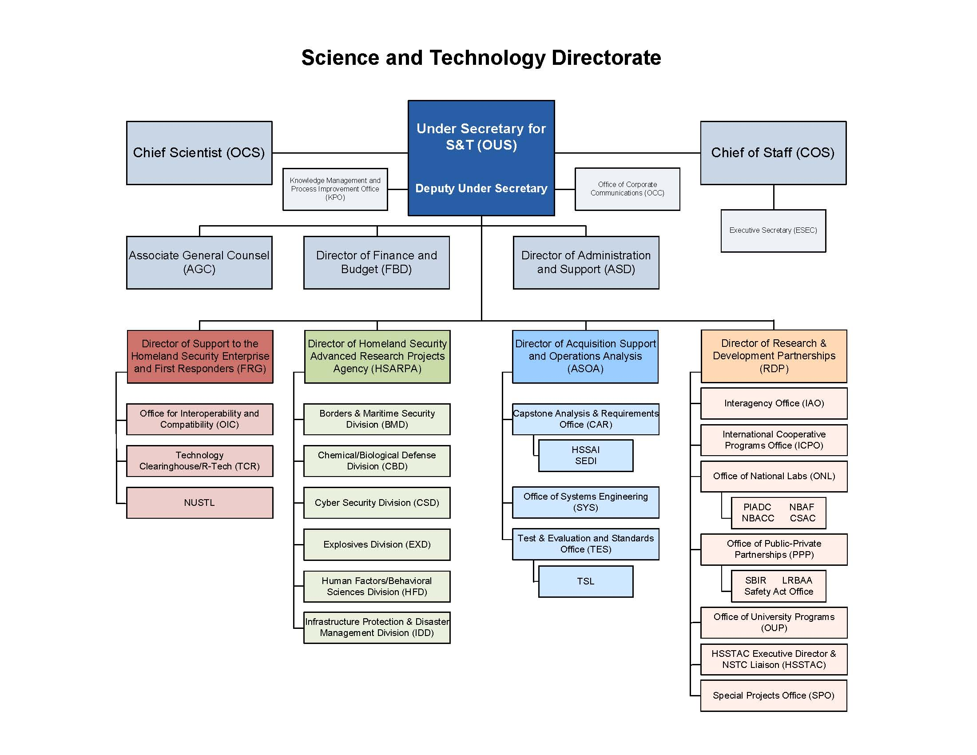

Science and Technology Directorate
Notes:
First Responder Group and the Homeland Security Enterprise (FRG)
Engages first responders to better understand their needs
Develops innovative solutions to address their most pressing challenges, from small- to large-scale emergencies
Homeland Security Advanced Research Projects Agency (HSARPA)
Facilitates research initiatives within six S&T technical divisions
Each Division focused on addressing a major threat
Enables multidisciplinary, team-based work that is essential for complex problem solving and strategic solutions
Acquisition Support & Operations Analysis (ASOA)
Provides technical and managerial expertise and resources to help DHS Components identify and acquire equipment, technology and services efficiently and affordably to better secure the nation
Research & Development Partnerships (RDP)
Collaborates throughout the federal government and private sector, as well as internationally
Creates partnerships and leverages non-S&T technological resources to deliver needed capabilities to the Homeland Security Enterprise

Slide 15
DHS S&T Directorate Lead Groups
Support to the Homeland Security Enterprise and First Responders Group (FRG)
Engages first responders to better understand their needs
Develops innovative solutions to address their most pressing challenges, from small- to large-scale emergencies
Helps practitioners identify requirements for transition to use
Homeland Security Advanced Research Projects Agency (HSARPA)
Facilitates research initiatives within six S&T technical divisions
Each Division focused on addressing a major threat
Enables multidisciplinary, team-based work that is essential for complex problem solving and strategic solutions
Acquisition Support & Operations Analysis (ASOA)
Provides technical and managerial expertise and resources to help DHS Components identify and acquire equipment, technology and services efficiently and affordably to better secure the nation
Research & Development Partnerships (RDP)
Collaborates throughout the federal government and private sector, as well as internationally
Creates partnerships and leverages non-S&T technological resources to deliver needed capabilities to the Homeland Security Enterprise

Slide 16






HSARPA Technical Divisions
Borders and Maritime Security Division - prevent contraband, criminals and terrorists from entering the U.S. while permitting the lawful flow of commerce and visitors
Chemical/Biological Defense Division - detect, protect against, respond to, and recover from potential biological or chemical events
Cyber Security Division - create a safe, secure and resilient cyber environment
Explosives Division - detect, prevent and mitigate explosives attacks against people and infrastructure
Human Factors/Behavioral Sciences Division - identify and analyze threats, enhance societal resilience, and integrate human capabilities in technology development
Infrastructure Protection & Disaster Management Division - strengthen situational awareness, emergency response capabilities and critical infrastructure protection
Notes:
Slide provides the broad brush strokes of the focus areas of the S&T Technical Divisions that provide the framework for much of the Directorate’s operations.
Examples of areas of focus for HSARPA include:
Saving lives and protecting the nation’s infrastructure against chemical, biological, and agricultural threats and disasters.
Protecting users, infrastructure, and the Internet by securing cyber systems and networks, making them resilient to cyber threats.
Developing technical capabilities to detect, respond, defeat, and mitigate non-nuclear explosives terrorism.

Slide 17
DHS SBIR – A Three-Phase Program
Phase I: Scientific and Technical Feasibility/Study | Funded with SBIR funds, 33% may be outsourced $100K for base effort for S&T Directorate’s SBIR not to exceed 6 months for base effort potential for additional $50K for Phase I option additional 4 months for option period $150,000 for DNDO’s SBIR
Phase II: Concept Development/ Prototype Demonstration | Funded with SBIR funds, 50% may be outsourced $750K for base effort for S&T Directorate’s SBIR not to exceed 24 months for base effort potential for additional $250,000 for Phase II option $1,000,000 for DNDO’s SBIR
Phase III: Product Development/ Commercialization Stage (non SBIR funds) | Funded with private or non-SBIR government sources No dollar or time limits Size standards do not apply For work that derives from, furthers the Phase I/Phase II effort, or brings to conclusion Can be sole-sourced; competition determined in Phase I
SBA threshold guidance, March 2010:
Phase I: $ 150,000
Phase II: $1,000,000

Slide 18
DHS SBIR: Treated as a Federal Procurement
DHS SBIRs are subject to the Federal Acquisition regulations (FARs)
Announcements, solicitations, schedules
Topics are determined by the government
Solicited proposals, review panels
Subject to a DCAA audit
DHS issues contracts, not grants, for its SBIR awards

Slide 19
DHS SBIR Evaluation Criteria
The soundness, technical merit, and innovation of the proposed approach and its incremental progress toward topic or subtopic solution
The qualifications of the proposed principal investigators, supporting staff, and consultants
Qualifications include not only the ability to perform the research and development but also the ability to commercialize the results
The potential for commercial (government or private sector) application and the benefits expected to
accrue from this commercialization
Cost reasonableness

Slide 20
DHS SBIR Evaluation Process
Proposals processed and made available to appropriate DHS technical program manager for evaluation and recommendation
PM seeks technical advice from qualified Federal Government employees and may seek advice from non-Federal Government
employees
Each proposal evaluated, on a competition basis, on its merit and relevance to the specific SBIR topic area, rather than against other proposals
Evaluators use an adjectival rating system for the criteria (except cost reasonableness):
Excellent Strongly Recommended for Funding
Very good Recommended for Funding
Good Fund Availability
Fair Fund Availability
Unacceptable Not Recommended for Funding

Slide 21
DHS S&T Directorate FY12.2 SBIR
FY12.2: DHSSBIR20122
Pre-solicitation posted: May 3, 2012
Full solicitation posted: May 17, 2012
Proposals accepted: May 3, 2012 – July 3, 2012
Contracts awarded: ~ September 2012
Now open
H-SB012.2-002 | Solid State Storage Investigative Tools for Law Enforcement | Cyber Security Division
H-SB012.2-002 | Automated Threat Recognition (ATR) Algorithms using Standardized Image File Formats | Explosives Division
H-SB012.2-003 | Objective, Quantitative Image Quality Measurements and Metrics for Screener Imaging Technologies | Human Factors Division
H-SB012.2-004 | Hardening for Commercially Available Hand Held Computing and Communications Devices for First Responders | First Responder Group
H-SB012.2-005 | Next Generation Textiles for Multi-Threat Personal Protective Equipment (PPE) | First Responder Group
Solicitation posted on:
www.fbo.gov
and linked on
https://sbir2.st.dhs.gov

Slide 22
SBIR Phase I Timelines
E
E
E
2 Solicitations Due Dates Reviews Awards Released Submission via the Federal reviewers; Firm-fixed-price contracts
Pre-solicitation released electronic system at non-Federal Government SMEs
15 days prior https://sbir2.st.dhs.gov
November January January – March mid-May
May June June – August late September
60 days
45 - 60 days
30 - 45 days
~ 4 to 4.5 months
from solicitation close to award

Slide 23
DHS SBIR Historical Statistics
 | FY04 $19M | FY05 $23M | FY06 $35M (includes STTR $ and data) | FY07 $25.2M | FY08 $19.3M (S&T = $12.6M DNDO = $6.7M) | FY09 $20.5M (S&T = $13.8M DNDO = $6.7M) | FY10 $22.1M (S&T = $15.5M DNDO = $6.6M) | FY11 $16.5M (S&T = $11.8M DNDO = $4.7M) | FY12 $12.9M (S&T = $8.2M DNDO = ~$4.7M)
Solicitation | 4.1/4.2 | 5.1/5.2 | 6.1/6.2 | 7.1/7.2 | 8.1/8.2 | 9.1/9.2 | 10.1/10.2 | 11.1/11.2 | 12.1/12.2
139 Topics | 8/6 | 6/6 | 10/6 | 10/7 | 5/4 4 | 7/8 2 | 6/9 2 | 6/6 3 | 6/5 7
2,943 Phase I Submissions | 347/158 | 215/207 | 191/177 | 236/184 | 187/80 24 | 121/155 18 | 146/125 38 | 90/108 21 | 115/TBD TBD
482 Phase I Awards | 66/31 | 32/30 | 45/28 | 38/23 | 14/8 6 | 17/30 5 | 16/27 8 | 17/18 9 | 14/TBD TBD
168 Phase II Awards | 21/13 | 11/17 | 19/7 | 13/12 | 7/5 4 | 8/9 3 | 6/8 4 | 1 * TBD | TBD TBD
Award Average
Phase I: ~ 16%
Phase II: ~ 35%
* Others pending
Key:
S&T data
DNDO data

Slide 24
DHS SBIR Historical Statistics Summary
DHS SBIR Program began in 2004; through FY12.1:
18 S&T solicitations and 5 DNDO solicitations released to date
139 topics
2,943 Phase I proposals submitted
482 Phase I awards
168 Phase II awards
Award Average
Phase I: ~ 16%
Phase II: ~ 35%
DHS SBIR Program Budget

Slide 25
DHS SBIR Historical Conversion Rates, FY04 –FY11
~ 17% of the 2,828
Phase I submissions received awards
Then, ~ 36% of Phase I awards received a Phase II award
And ~ 10% of Phase II projects received
Phase III contracts
~ $25M non-SBIR investment
Number of Phase I Companies
Phase I
Selection
Phase II
Conversion
Phase III
Commercialization
DHS SBIR is a highly competitive process;
award recipients are moving towards commercialization.

Slide 26
How “Small” is the SBC that Proposes to and Receives Awards from the DHS SBIR Program? (FY04.2 – FY12.1 data)
64% Phase I submissions from SBCs with fewer than 24 employees
50% Phase I awards to SBCs
with fewer than 24 employees
Percent of Phase I Companies
Number of Employees

Slide 27
DHS SBIR Phase I Data from 17 Competitions through FY12.1*
WA
59/12
ME
13/1
MT
9/2
ND
1/0
OR
22/5
MN
44/7
VT 10/1
ID
8/0
SD
1/0
NY
112/28
NH 29/6
WI
13/2
MI
82/10
MA 323/71
WY
2/0
RI 7/1
IA
4/0
PA
71/10
CT 51/8
NE
7/1
NV
20/1
IL
53/7
IN
40/4
OH
54/1
NJ 80/8
UT
30/7
CO
77/12
WV
10/1
DE 13/0
CA
596/111
KS
7/1
MO
20/3
VA
281/40
KY
10/1
MD 191/25
DC 5/0
TN 21/1
NC 32/5
AZ
53/10
NM
48/7
OK
11/4
AR
3/0
SC
9/1
MS
6/0
AL
61/7
GA
42/3
TX
150/23
LA
19/2
AK
3/1
FL
106/13
PR 3/0
Total Phase I
Submissions/Awards
2,943/468
HI
18/3
*Includes STTR data

Slide 28
DHS SBIR/STTR Phase I Awards vs. Submissions by U.S. Regions
(FY04.1 – FY12.1 data)

Slide 29
DHS S&T Directorate SBIR is Making a Difference
317 companies in 42 states have received S&T SBIR funding
15 companies filed 35 patent applications
22 patents issued; others pending
17 commercial products in the market
125 net new jobs created (excluding mergers and acquisitions)
data from 54 companies responding to the July 2010 questionnaire

Slide 30

SBIR Companies: 28 Merger and Acquisition Activities
SBIR Company | Activity
Access Data Corporation | Merged with CT Summation, 2010 New company is AccessData Group, LLC
Acoustech Corporation | Acquired by Applied Physical Sciences, 2006
Aculight Corporation | Acquired by Lockheed Martin, 2008
AETC, Inc. | Acquired by SAIC, 2006
Aguila Technologies, Inc. | Acquired by Creative Electron, Inc., 2008
CounterStorm, Inc. | Acquired by Trusted Computer Solutions (TCS), 2008 TCS was acquired by Raytheon, 2010
Crucial Security, Inc. | Acquired by Harris Corporation, 2009
Dolphin Technology, Inc. | Acquired by ITT Corporation, 2007
Endeavor Security, Inc. | Acquired by McAfee, 2009
Geospatial Systems, Inc. | Acquired by Optech Incorporated, 2010
Harris Acoustic Products Corp. | Acquired by Ultra Electronics Holdings PLC, 2008
HG Gary, Inc. | Acquired by ManTech International Corporation, 2012
Komoku, Inc. | Acquired by Microsoft Corporation, 2008
LewTech Company, Inc. | Acquired by Logikos, 2010
Lynntech, Inc. | Acquired by Astin Partners, 2007
…. continued

Slide 31
SBIR Companies: 28 Merger and Acquisition Activities
SBIR Company | Activity
Maxion Technologies, Inc. | Acquired by Physical Sciences Inc., 2009
MesoSystems Technology, Inc. | Acquired by ICx Technologies, 2005
Nomadics, Inc. | Acquired by ICx Technologies, 2005
PercepTek, Inc. | Acquired by Lockheed Martin, 2007
Picometrix LLC | Acquired by Advanced Photonix, Inc., 2005
Radiation Monitoring Devices, Inc. | Acquired by Dynasil Corporation, 2008
S5 Wireless, Inc. | Acquired by Recon Dynamics LLC, 2010
Seahawk Biosystems Corporation | Purchased by Tetracore Inc., 2008 Operates as a subsidiary of Tetracore, Inc.
Solidcore | Acquired by McAfee, 2009
SpaceMicro, Inc. | Formed a new subsidiary, 2008 New subsidiary is SD Technologies, Inc. (SDTI)
SPADAC, Inc. | Acquired by GeoEye Inc., 2010
Syagen Technology, Inc. | Acquired by Morpho Detection, 2011
Tera Research, Inc. | Acquired by McAulay-Brown Inc., 2008

Slide 32
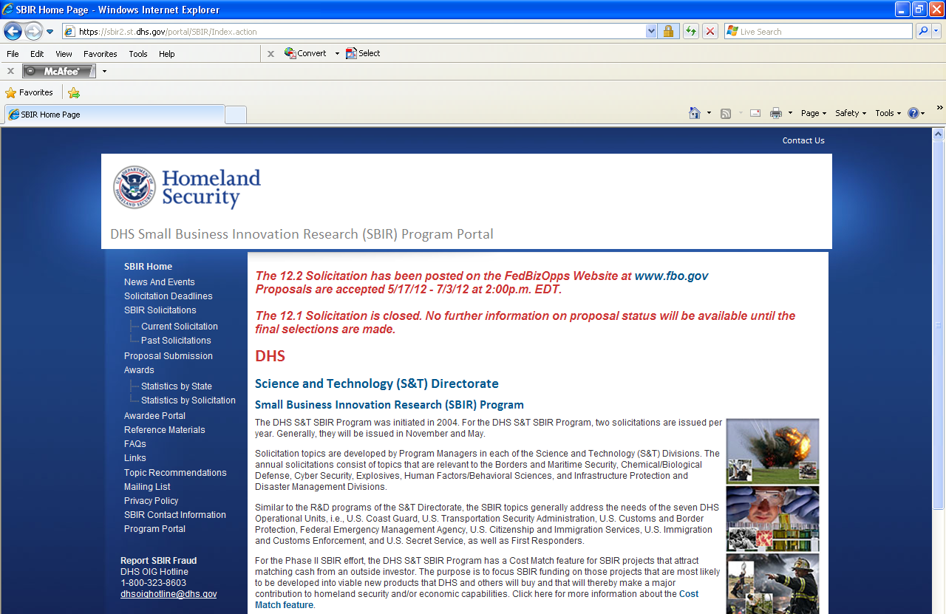
https://sbir2.st.dhs.gov
Topic
Recommendations
Topic
Recommendations
Mailing List

Slide 33
Useful Web Sites and DHS SBIR Points of Contact
Elissa (Lisa) Sobolewski
DHS SBIR Program Director
elissa.sobolewski@dhs.gov
(202) 254-6768
Francis (Frank) Barros
DHS SBIR Program Analyst
francis.barros@dhs.gov
(202) 254-6966
S&T Directorate SBIR Program Inquiries
STSBIR.PROGRAM@dhs.gov
Kevin Gutierrez
DHS DNDO Program Manager
kevin.gutierrez@dhs.gov
(202) 254-7610
DNDO SBIR Program Inquiries
dndosbir@hq.dhs.gov
Useful Web Sites
https://sbir2.st.dhs.gov
https://baa2.st.dhs.gov
https://www.dhs.gov/xabout/
structure/editorial_0766.shtm
www.dhs.gov
www.dhs.gov/xopnbiz/
www.fbo.gov
www.sbir.gov

Slide 34


